Slide 1
Creating an Inventory of U.S. Medical Devices
Author: Christopher Bach
University of Maryland, College Park; B.S. Bioengineering
Mentor: Tyler Peryea

Slide 2
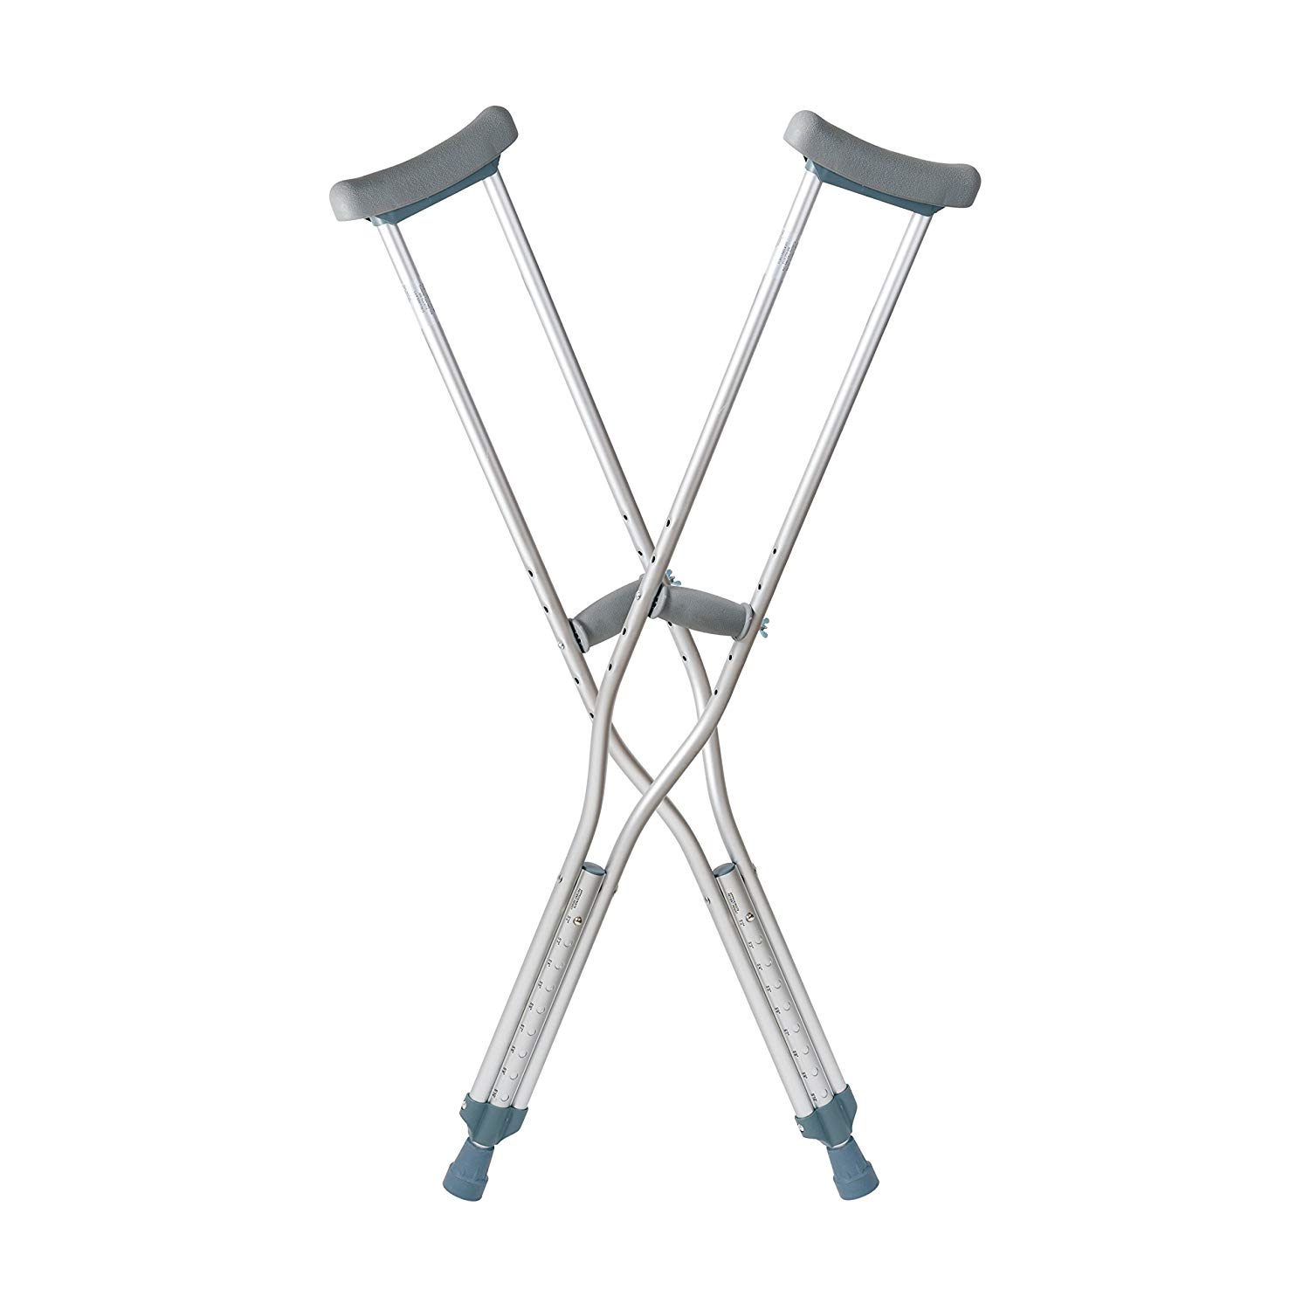

How many medical devices are there?
Notes:
Make Simpler, “It’s complicated”

Slide 3
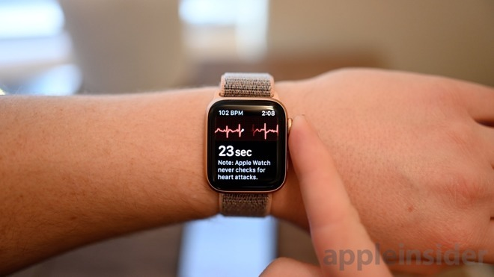
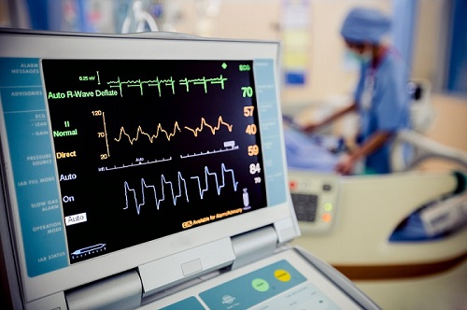
What is a Medical Device?
An object that:
Treats or diagnoses a disease OR
Alters biological functions or structures
Works externally or internally
Is not a drug
=
Notes:
https://www.fda.gov/medical-devices/resources-you-medical-devices/consumers-medical-devices
Just say plastic surgery

Slide 4
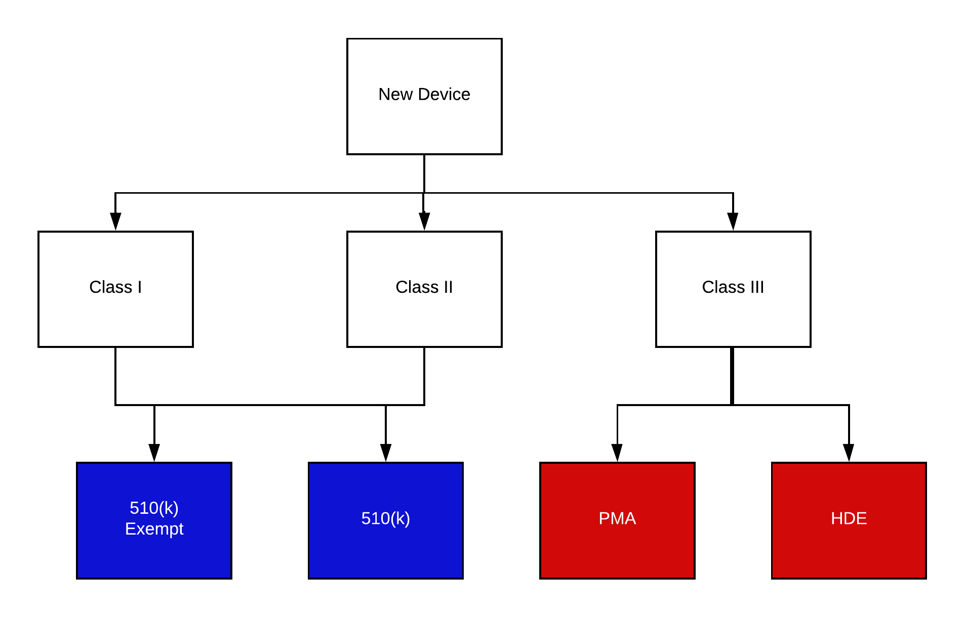
FDA Medical Device Classification
Cleared
Approved
Notes:
Color code based off approval, cleared, legally marketed, etc.

Slide 5
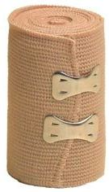
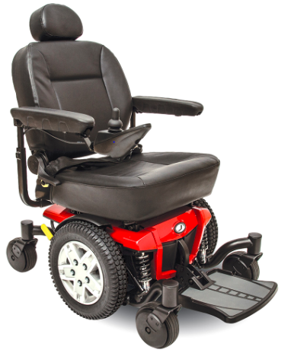
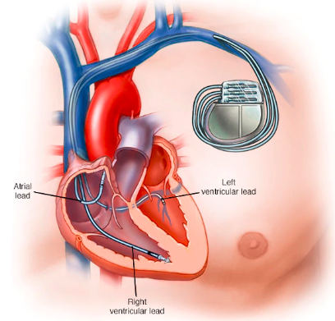
FDA Classes
Class I: Low risk
Class II: moderate risk
Class III: life support, high risk
Notes:
https://www.fda.gov/medical-devices/resources-you-medical-devices/consumers-medical-devices

Slide 6
Requirements
PMA: most stringent, require scientific evidence, Class III
IND and NDA
510(k): prove substantially equivalent (SE) a device already
ANDA and Generics
510(k) Exempt: Only requires registration
OTC
Humanitarian Device Exemption (HDE): for Humanitarian Use Device (HUD), less than 8,000 people
Orphan Designation
Notes:
https://www.fda.gov/medical-devices/resources-you-medical-devices/consumers-medical-devices
https://www.fda.gov/patients/device-development-process/step-3-pathway-approval
Apple watch
PMA=Class II
Remind about Questrion

Slide 7
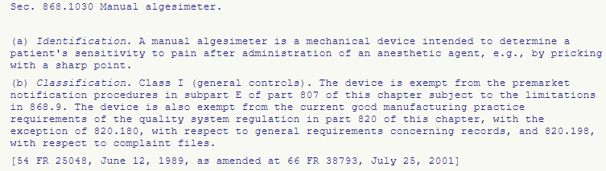



Code of Federal Regulations (CFR)

Slide 8
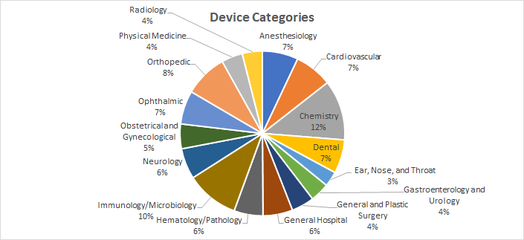
How many devices:
2026!

Slide 9
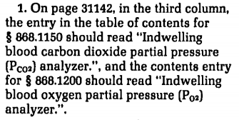


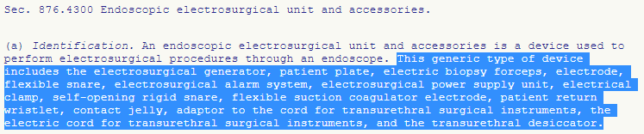
Complications
Insignificant Data
Multiple Entries
More Databases...
Notes:
http://cdn.loc.gov/service/ll/fedreg/fr047/fr047178/fr047178.pdf

Slide 10
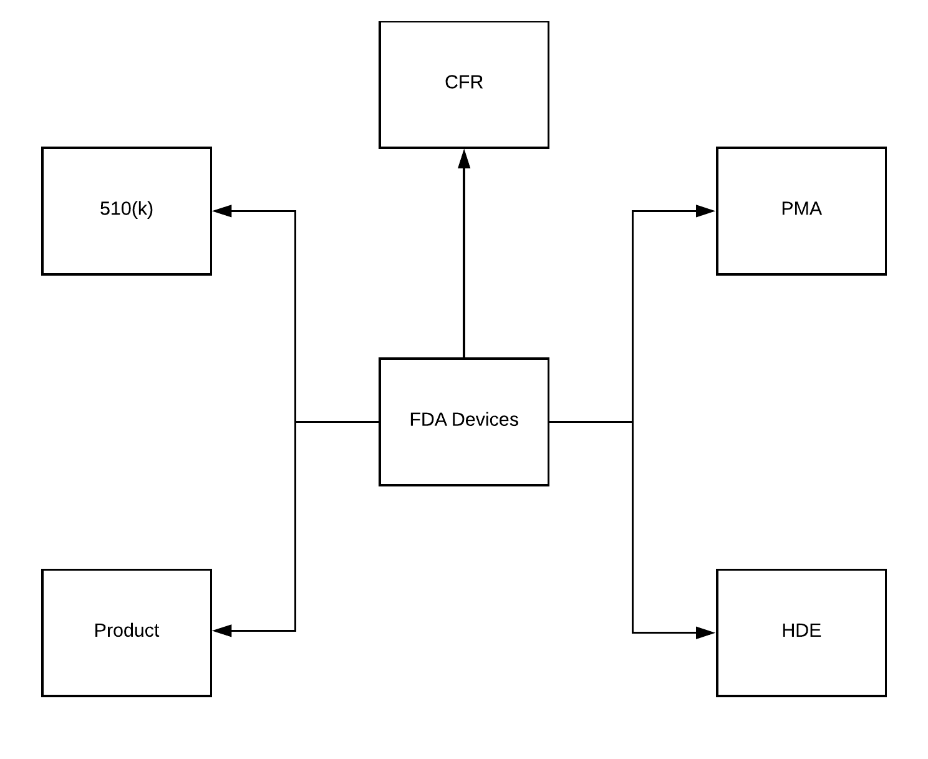
Database

Slide 11
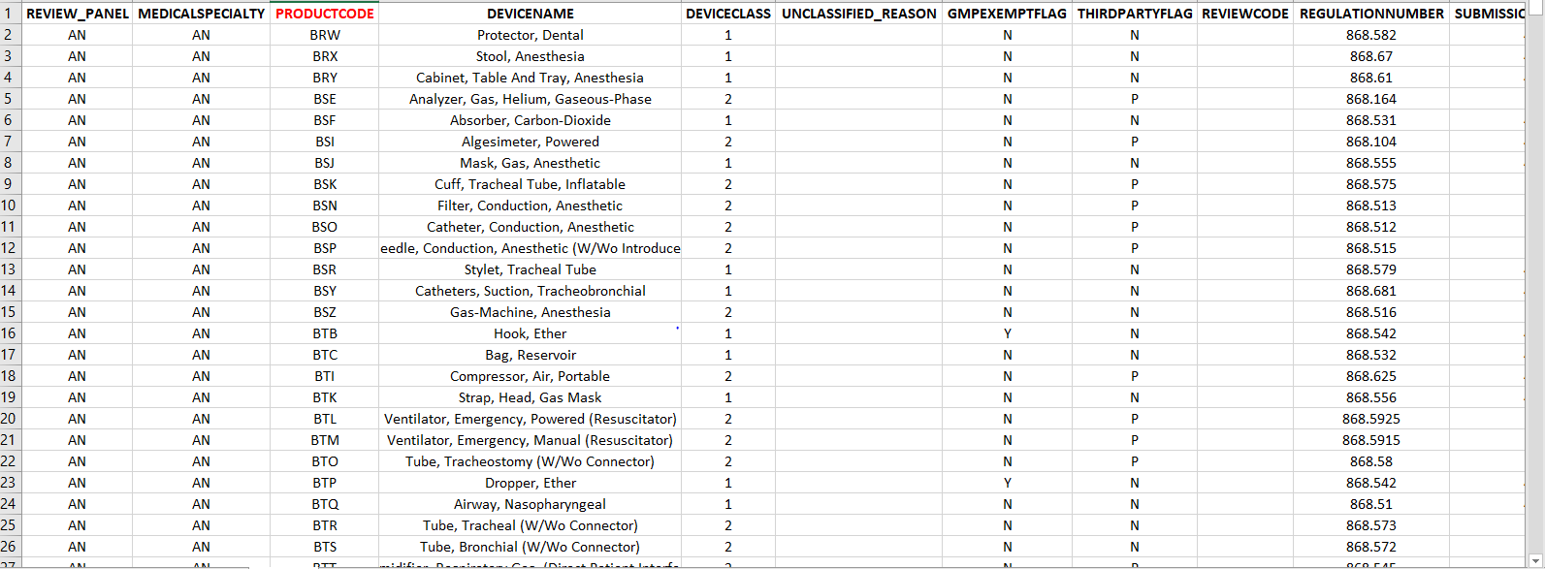
How many devices:
2026!
6412
Notes:
IF you use this you consider
CFR=Legal Format; Product Classification = Data Format; Inconsistent and Missing Data; “Questionable” Medical Devices

Slide 12
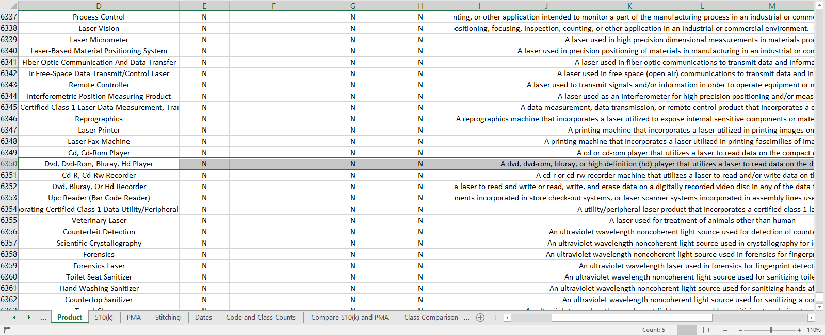

Slide 13
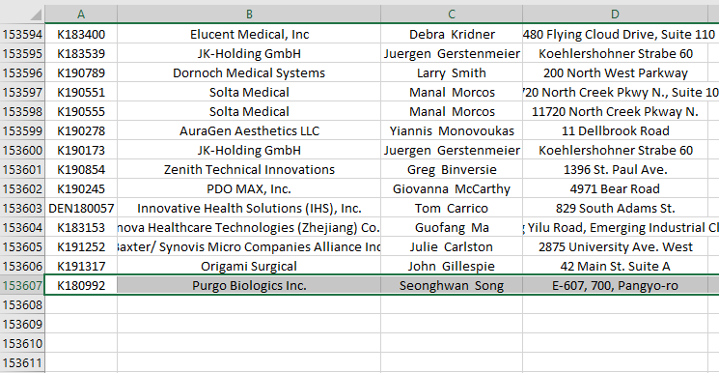
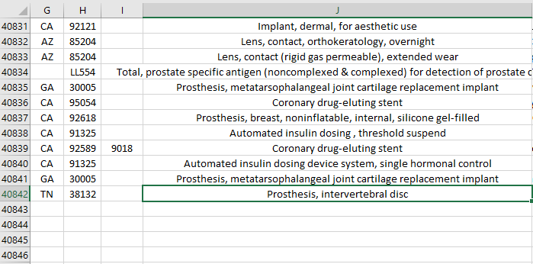
How many devices:
2026!
6412
194447?
+
PMA = 40841
510(k) = 153606
Notes:
IF you use this you consider

Slide 14
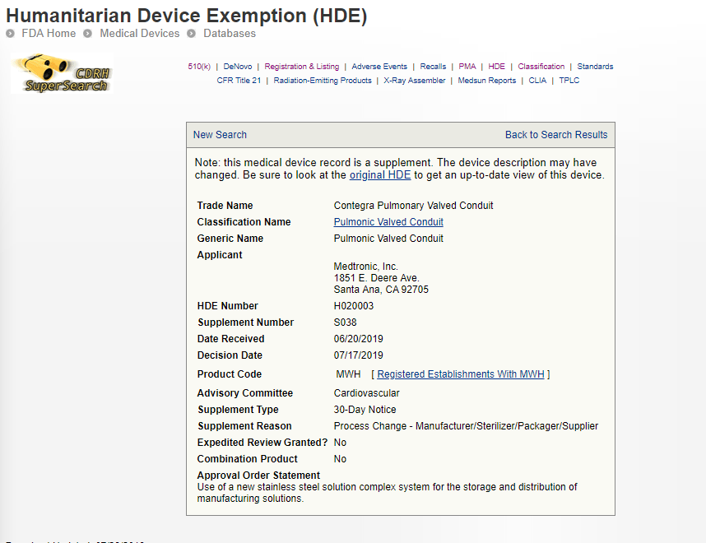
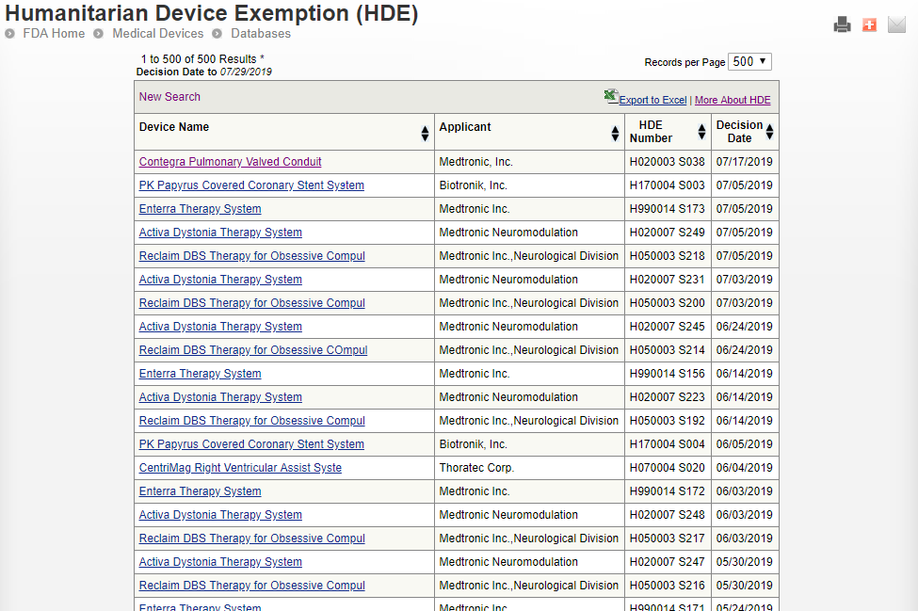
HDE Database

Slide 15
How many devices:
2026!
6412
194447?
It’s Complicated
Notes:
IF you use this you consider

Slide 16
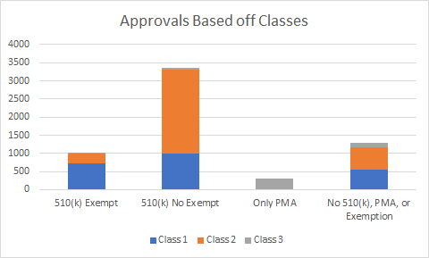
Analyze What We Know

Slide 17
How many devices:
2026!
6412
153607+40842?
It’s Still Complicated
(At least 4657, though)
Notes:
IF you use this you consider

Slide 18
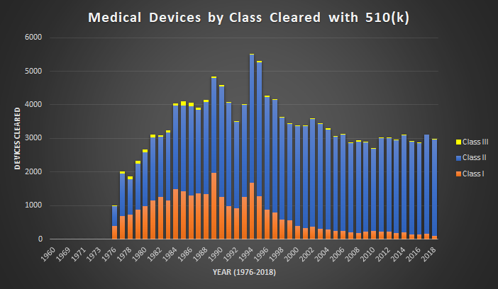
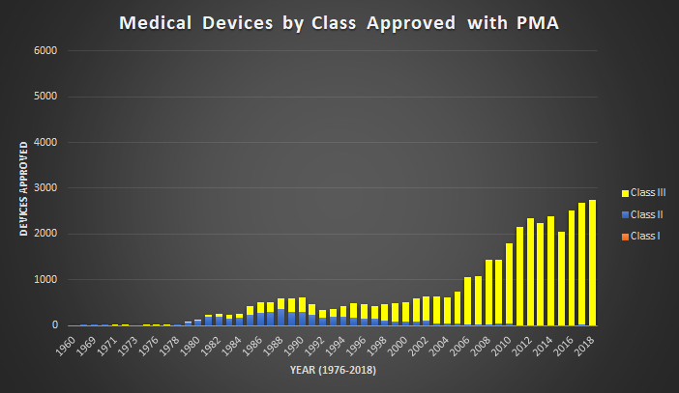
510(k) and PMA Classes
Notes:
1994-1996: Exemption

Slide 19

Future Direction
Look into other databases
De Novo, MAUDE, MedSun, CLIA
Matching Diseases/Ailments
Medical Devices

Slide 20
Acknowledgements
Trung Nguyen
Alexey Zakharov
Vishal Siramshetty
Williams Song
Lawrence Callahan

